Slide 1
INVESTMENT ASSIGNMENT SUBMISSION
Name: Debayan Talapatra

Slide 2
Objectives
Spark Funds wants to invest between 5 to 15 million USD per round of investment. This investment will only go to top English speaking countries because of ease of communication.
The idea of this analysis is to identify the best sectors, countries, and a suitable investment type for making investments keeping the constraints in mind.
The overall strategy is to invest where others are investing, implying that the 'best' sectors and countries are the ones 'where most investors are investing'.

Slide 3
Methodology
Compare the investment amounts in all
fund types and chose the best fund type
as per the objective.
Select the top 3 English speaking
countries with the most investments in
the chosen fund type.
Select the most heavily invested sector in
the 3 countries and also the top invested
company in all 3 countries.

Slide 4
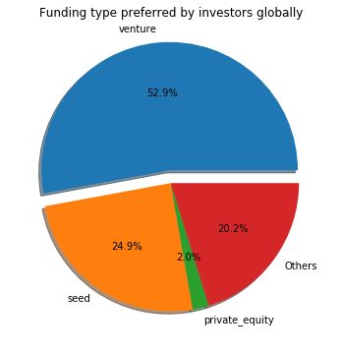
Chosing the most suitable fund type
There were two files :-
companies.csv - It contained the name and address of companies.
rounds2.csv - This contained the type of fund and the amount invested in the companies in companies.csv.
Removed the rows where investment amount were missing. Missing values in other coulmns were not removed since if those rows had some investments, it would impact the analysis. Our main objective is to find the most suitable investment fund type, so each investment data was taken into consideration.
Grouped all the fund types according to there total investments by keeping the fund types as index and the total investment in each fund was the column.
Used the mean() method on the total invetment column to find the average investment in funds..
As per the analysis, “Venture” fund is the most suitable fund for investments since its average investment amount is in the range of 5 - 15 million and it constitutes around 52.9 % of the total investments globally.
Among Venture, Private Equity and Seed Funds, Venture funds has a share of 66.3 %.

Slide 5
Chosing the top 3 countries for investment
From the master_frame, created a pivot table where the countries are the index and the different investment fund types are the columns.
Created another DataFrame from that table which consists of the countries and their respective total investment under Venture funds.
Sorted that DataFrame to find the top countries where most Venture fund investment has occured.
The Top 4 countries where highest amount of Venture investments have occured are USA, Great Britain, China and India.
Since the objevtive is to select countries which has English as official language, so its clear that USA, Great Britain and India are countries with most Venture investments.

Slide 6
Find the top sectors in top 3 countries
Extracted the primary category from the category_list column and used the mapping file 'mapping.csv' to map each primary sector to one of the eight main sectors.
A dataframe created in previous step is merged with master_frame.
Separate dataframes are created for top 3 countries and all of them contains -:
The total number (or count) of investments for each main sector in a separate column
The total amount invested in each main sector in a separate column.
Based on the analysis of the sectors, it was founded that -:
Country | Top Sector | Top Company
USA | Others | Virtustream
GBR | Others | Electric Cloud
IND | Others | FirstCry.com

Slide 7
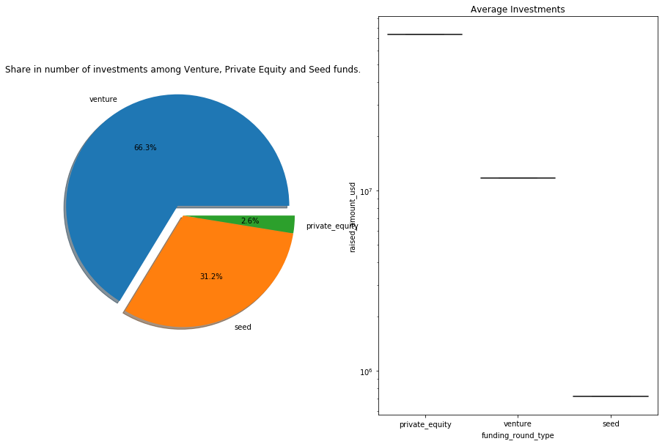
Share of Venture, Private, Seed and their average investments

Slide 8
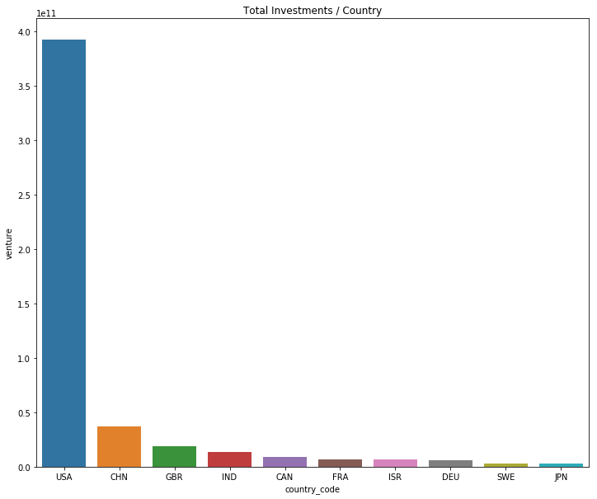
Showing the top 3 countries in Venture investments

Slide 9
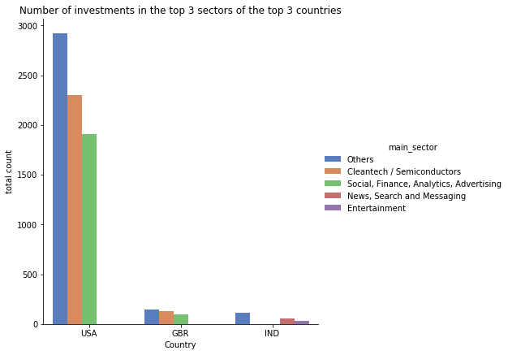
Showing top 3 sectors in top countries

Slide 10
Spark Funds should make Venture Fund investments in any of the top companies in any of the top sectors of USA, Great Britain or India.
Thank You.

